Slide 1
Git
software version control
Mats Vande Cavey

Slide 2
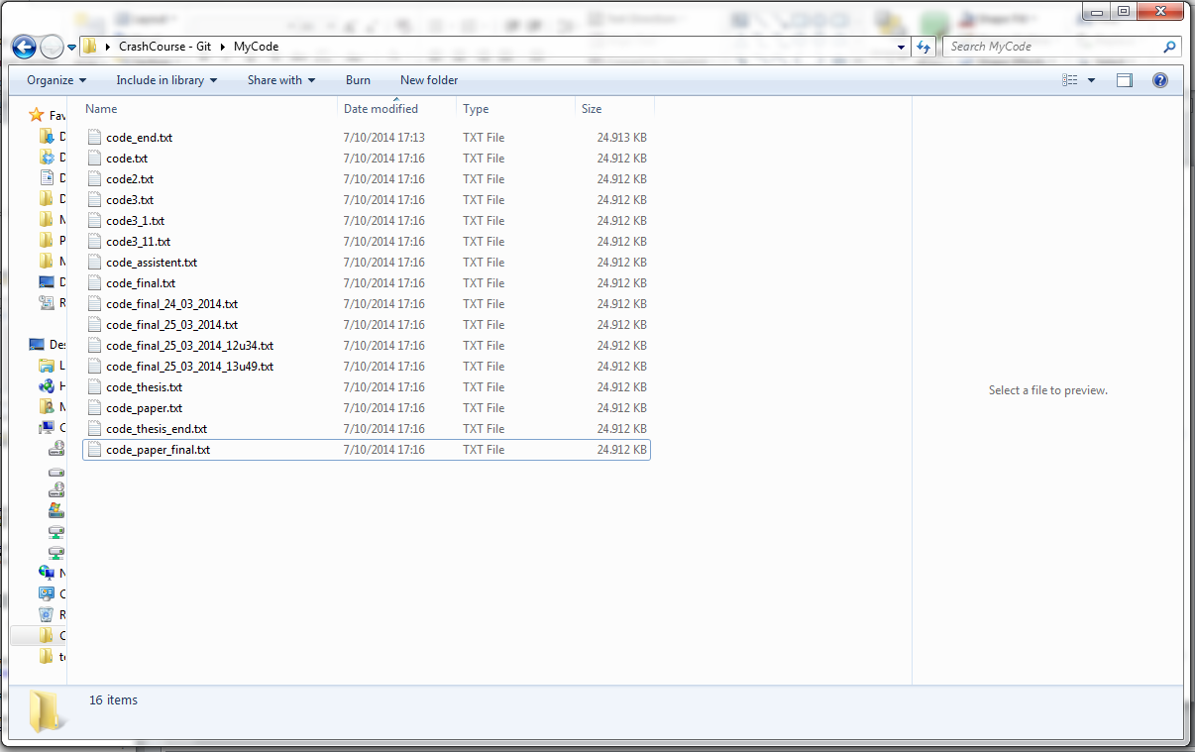

Slide 3
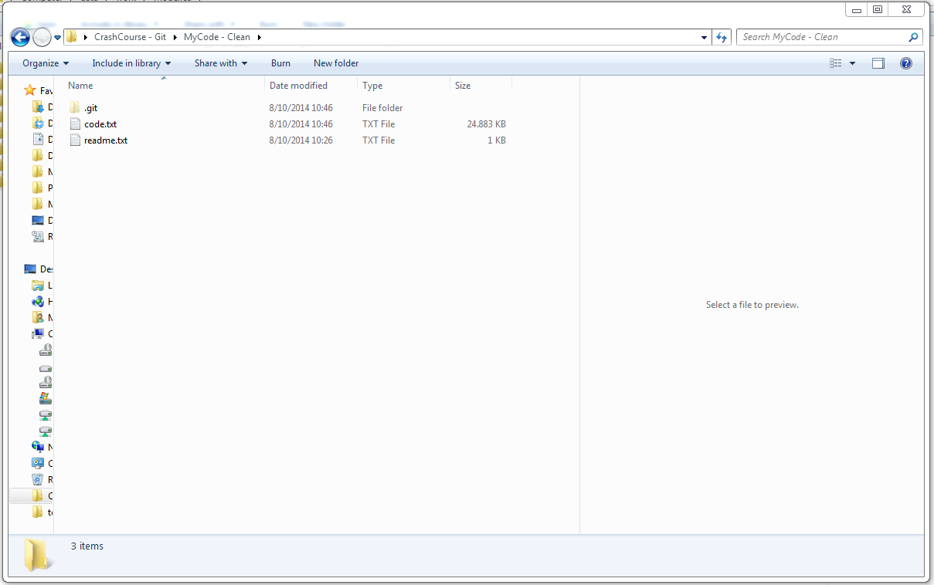

Slide 4
Overview
Git
Create repository
Link to remote (online back-up)

Slide 5
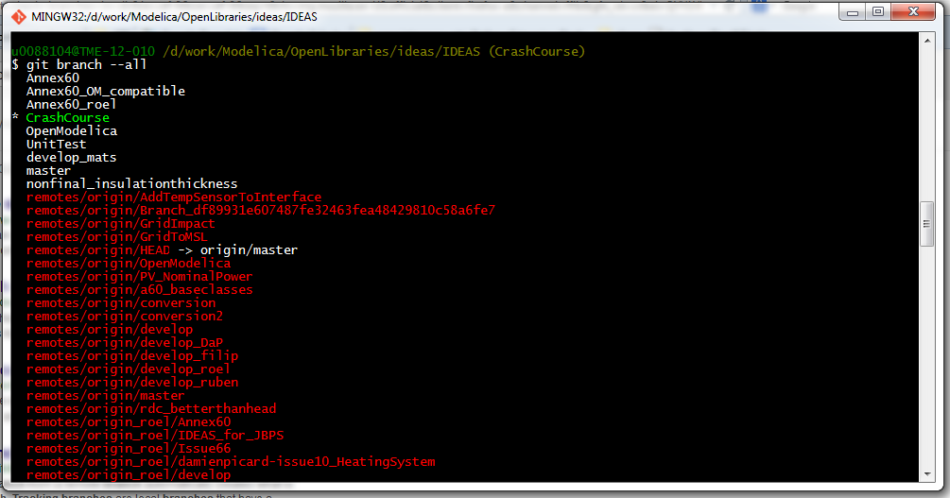
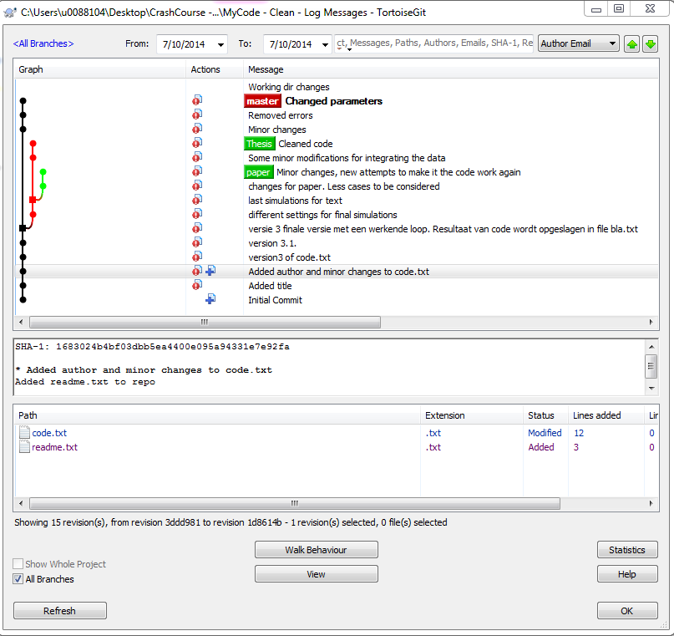
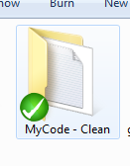
Git -Software version control
Keep track of versions
Find changes
Backup code (online)
Cooperate with others
Default: command line
GUI software: TortoiseGit

Slide 6
Commit
Commit = snapshot of your code
Git will remember the content of all files that were in directory at that time. Go back to this version at any given moment!
Git keeps track of new files and changes and allows you to compare with previous versions (commits)
Going back to a commit means the files are changed in your directory

Slide 7
Initial commit
Hello world
Code.txt

Slide 8
Commit new file and changes
Hello world
Print ‘Hello world’
Code.txt
Code.txt
This is a test repository
readme.txt

Slide 9
Commit changes
Hello world
Print ‘Hello world’
Print ‘Hello world, I just made my first program’
Code.txt
Code.txt
Code.txt
This is a test repository
This is a test repository
readme.txt
readme.txt

Slide 10
Working directory – code not working
Hello world
Print ‘Hello world’
Print ‘Hello world, I just made my first program’
Print ‘Hello world, I just made my first program’
ùùùùùùùùùùùùùùùùùùùùùùùùùùùùùù
Code.txt
Code.txt
Code.txt
Code.txt
This is a test repository
This is a test repository
This is a test repository
readme.txt
readme.txt
readme.txt

Slide 11

TortoiseGit
Download TortoiseGit at
https://code.google.com/p/tortoisegit/
Reboot Computer

Slide 12
Overview
Git
Create repository
Save new version as commits
Compare revision
Go back to earlier version
Branch out (try new implementation)
Link to remote (online back-up)

Slide 13
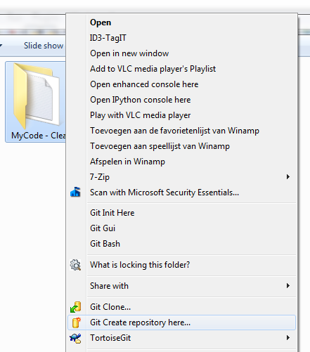
Create new local repository

Slide 14
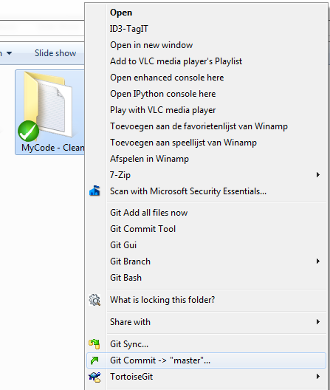
Commit via Tortoise Git

Slide 15
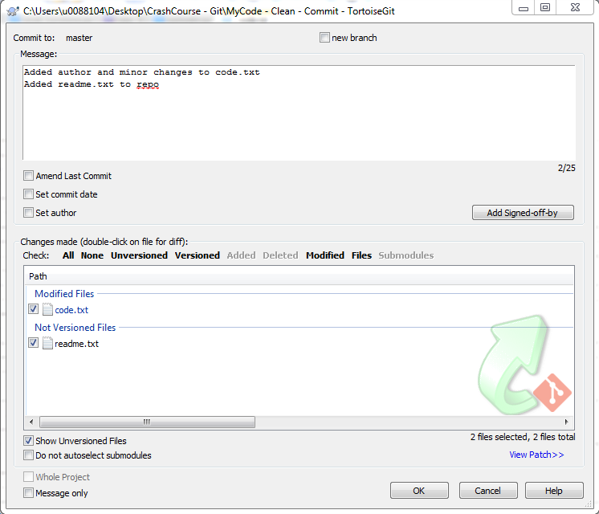
Changes and commit message

Slide 16
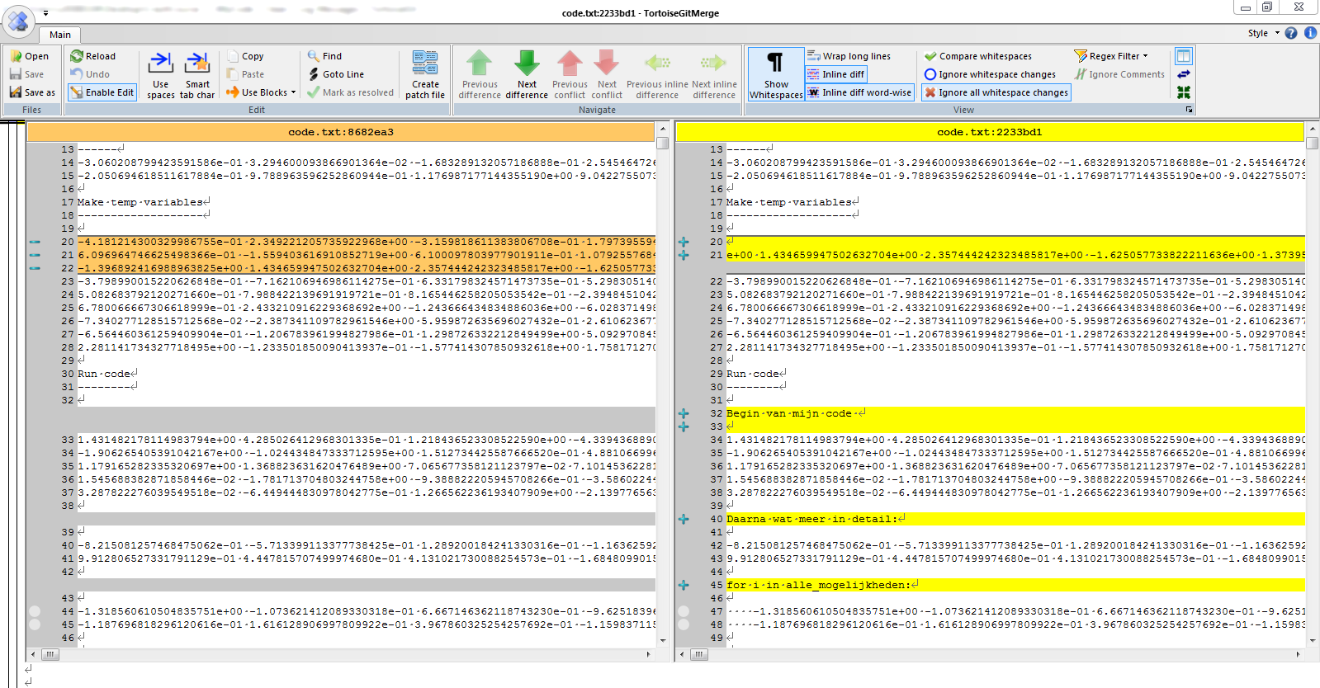
Compare 2 versions of files

Slide 17
Changes and commit message

Slide 18
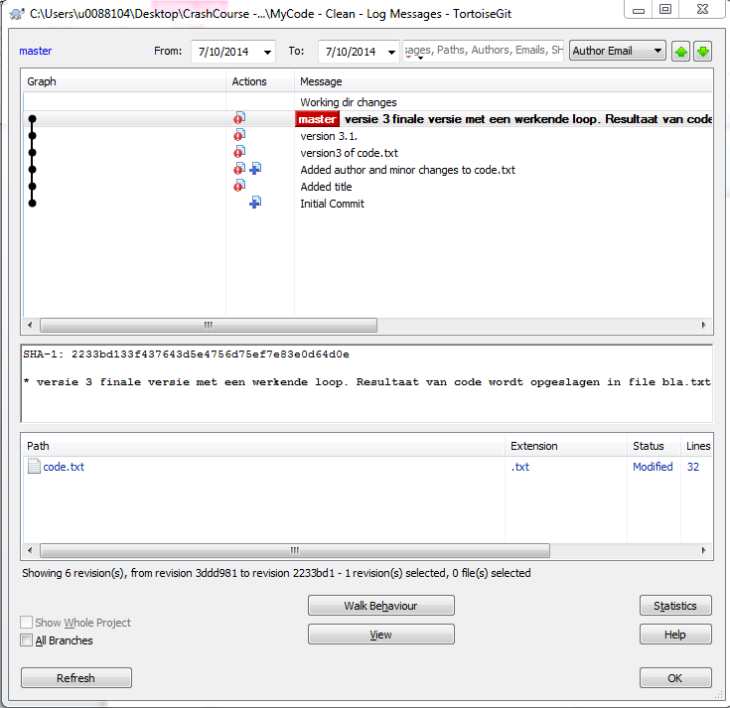
Overview of commits (log)

Slide 19
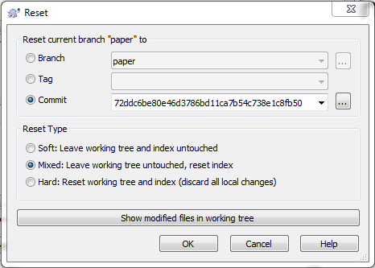
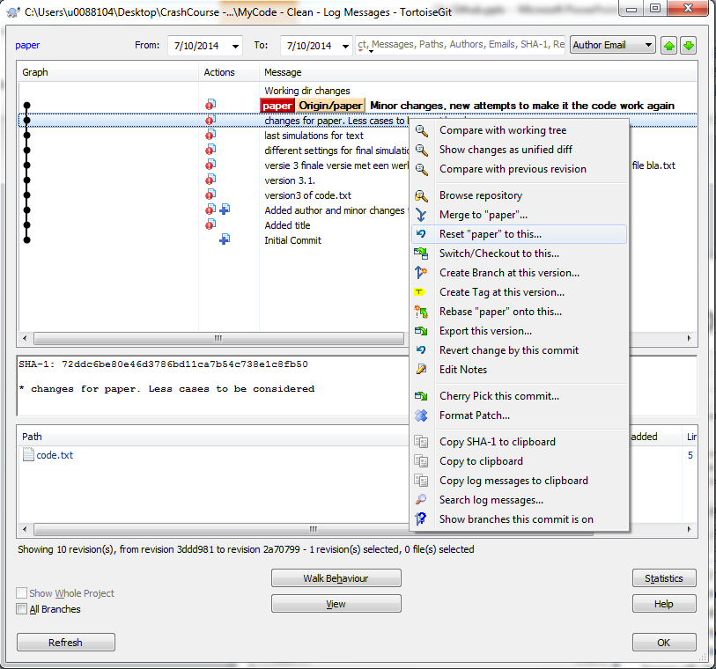
Reset branch to former commit
Soft: (rare) e.g. to amend commit earlier than last commit
Mixed: undo commit, but leave files as they are in directory
Hard: go back to previous commit, loose all changes

Slide 20
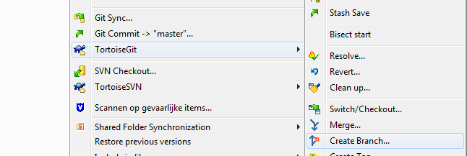
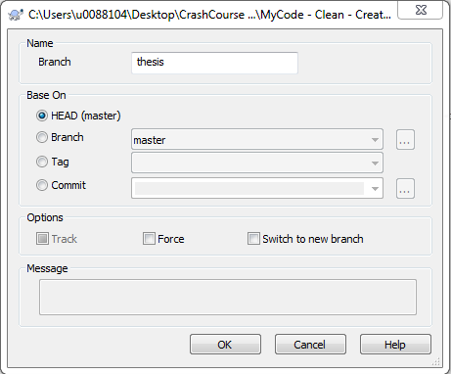
Branching – ‘thesis’

Slide 21
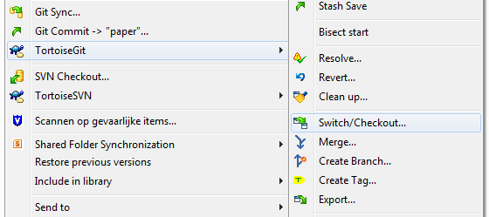
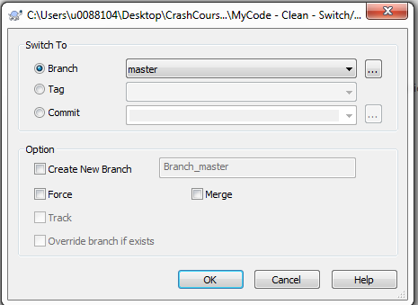
Checkout other branch

Slide 22
Final version of local repo

Slide 23
Git
Create repository
Create online repository (online back-up)
Set up remote
Push to/pull from remote
Teamwork

Slide 24

Remote repository (online backup)
Account at:
github.com
Public
bitbucket.org
Public
Private
Origin (private)
Remote
https://github.com/user
PC User
Local
= branch

Slide 25
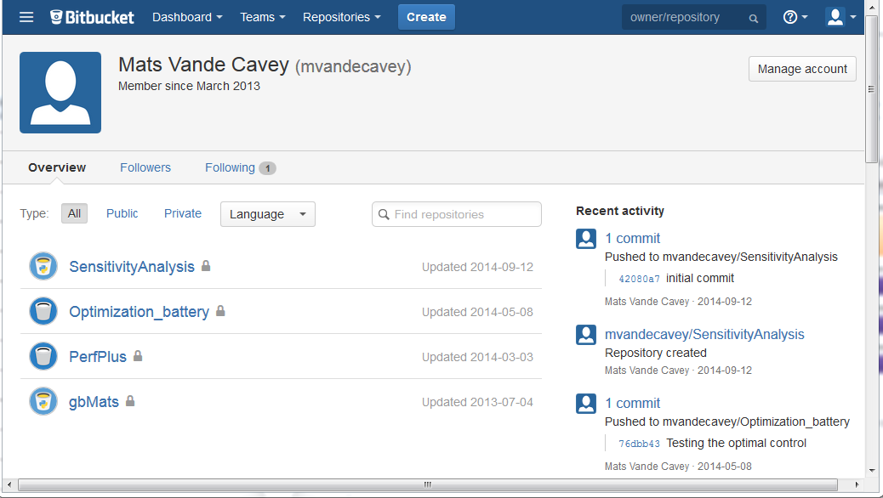
Remote (online) repositories

Slide 26
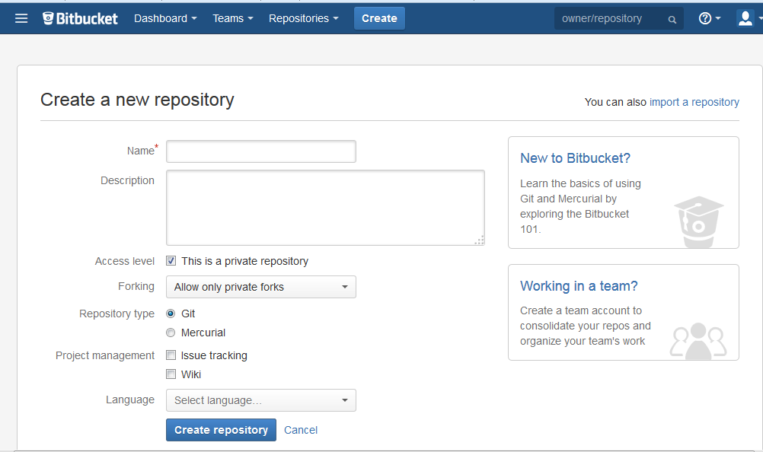
Create remote repo

Slide 27
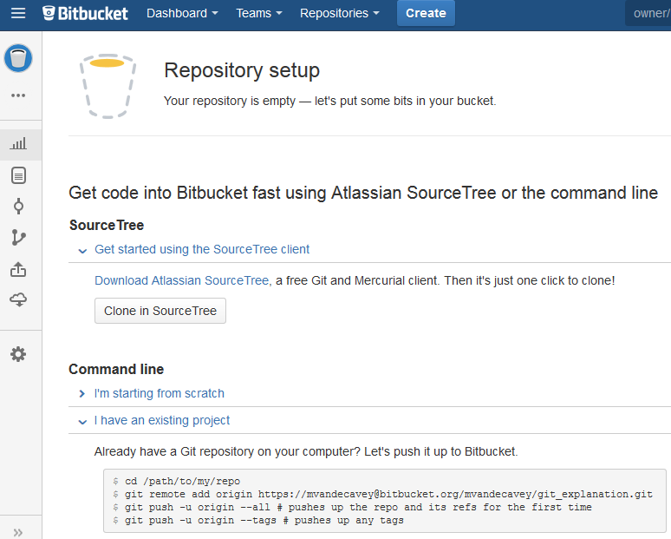
Remote URL for this project
Origin (remote) URL

Slide 28

Link local - remote
Origin (private)
Remote
https://github.com/user/project
Push
Pull
project
PC User
Local

Slide 29

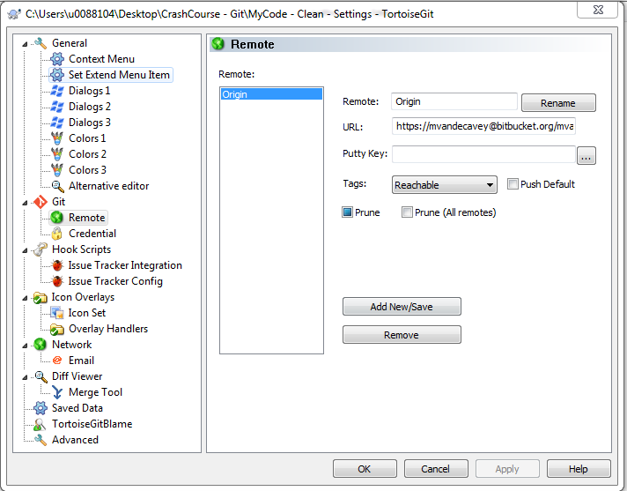
Settings
Origin (remote) URL

Slide 30
Git – software version control
Origin (private)
Remote
https://github.com/user
Push
Pull
clone
PC User
Local

Slide 31
Upstream (official)
fork
Origin (private)
e.g. GITHUB
(Cloud)
user/project
user1/project
Pull request accept my changes pls!
Push
Pull
Push
Pull
Push
Pull
Clone
Clone
Clone
PC User
PC User1
project
project
= branch

Slide 32
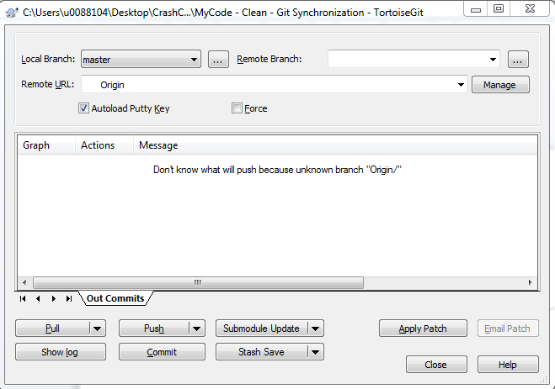
Practical -Pull new version
Pull from any Remote Branch (select Remote URL) to any Local Branch
Commit all local changes before pull (necessary)
Resolve (possible) conflicts in files + merge changes
Commit merged

Slide 33
Practical –Push new version
Push from any Local Branch to any Remote Branch (select Remote URL)
Commit all local changes before push
Pull remote first..
Push

Slide 34
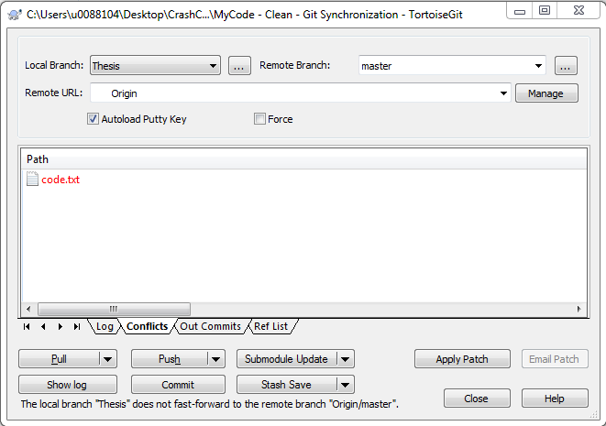
Pull example
Pull ‘master’ (remote: origin) to ‘Thesis’
Conflict in file: ‘Code.txt’

Slide 35
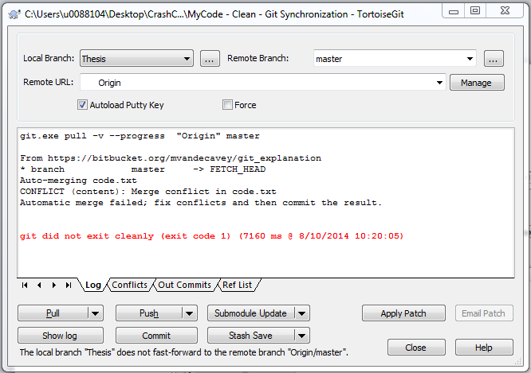
Pull example
Pull ‘master’ (remote: origin) to ‘Thesis’
Conflict in file: ‘Code.txt’
Resolve conflict!

Slide 36

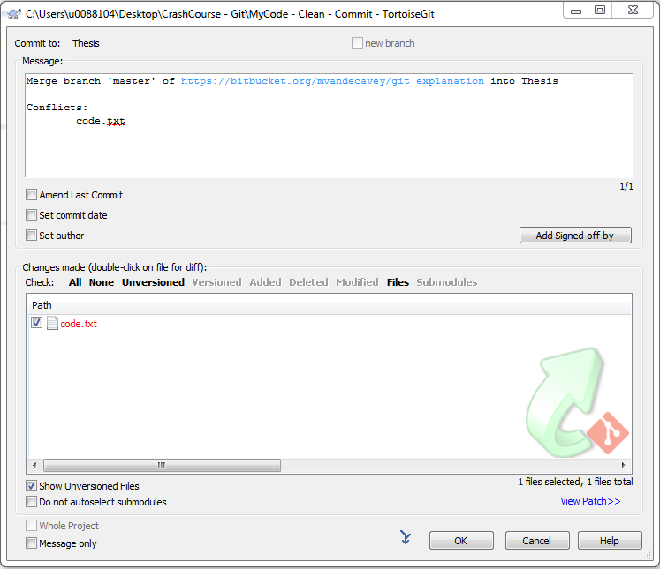
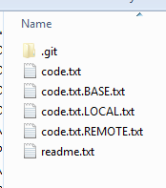
Resolve conflict
Fix conflict:
Double click

Slide 37
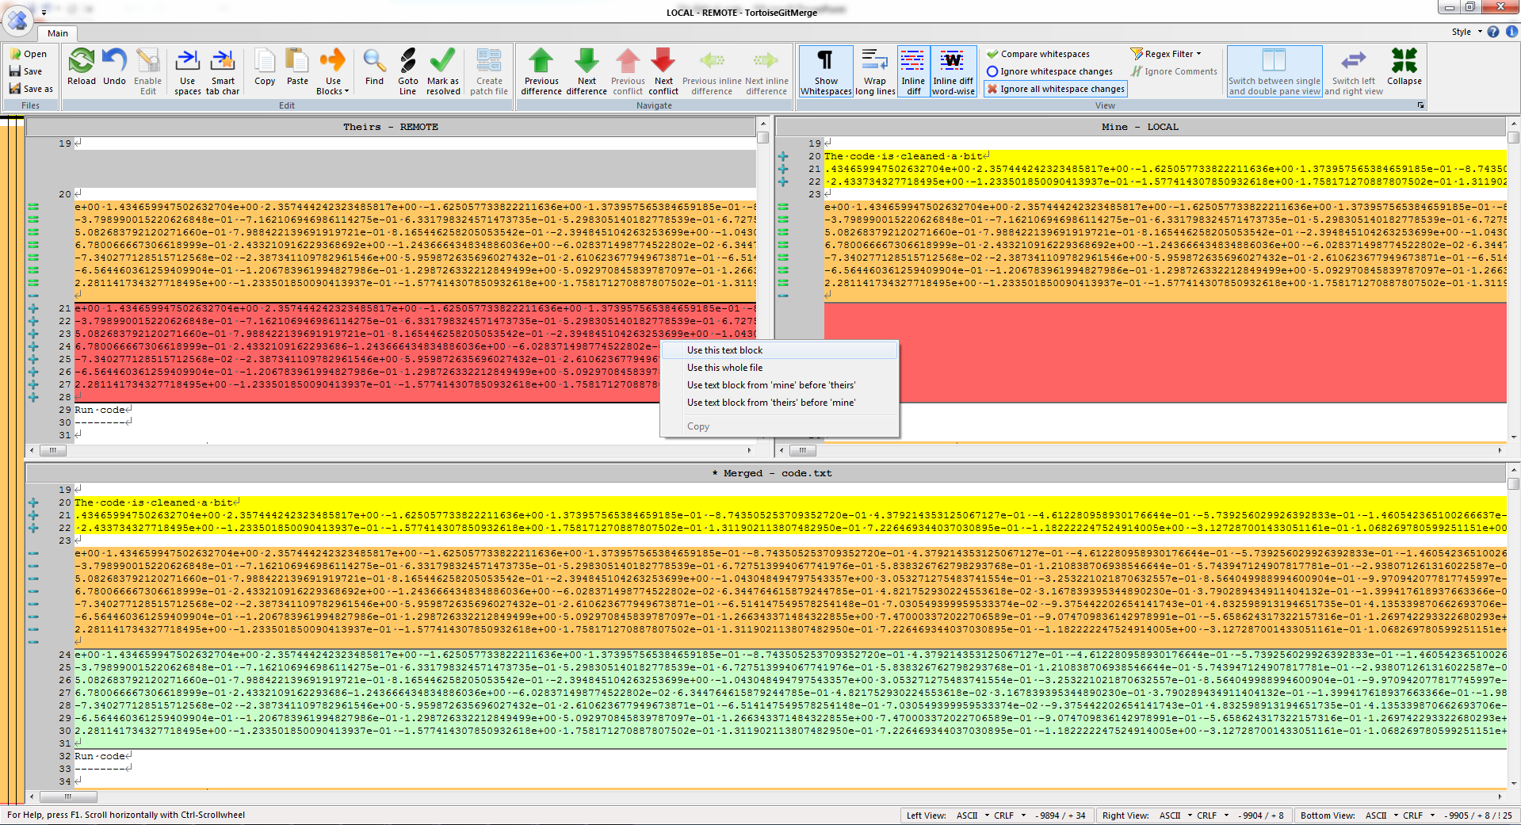
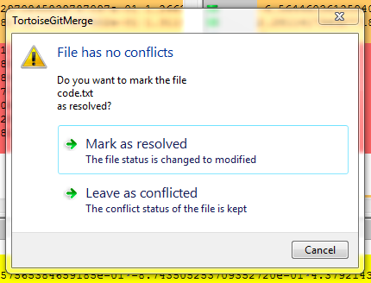
Resolve conflict (2)
Theirs - remote
Mine - Local
Merged – code.txt
+ commit merged
+ push / pull request merged

Slide 38
More information
http://gitimmersion.com/
https://confluence.atlassian.com/display/BITBUCKET/Bitbucket+101
http://nathanj.github.io/gitguide/
http://ftp.newartisans.com/pub/git.from.bottom.up.pdf
http://www.lynda.com/Git-tutorials/Git-Essential-Training/100222-2.html (Transcripts only)

